Slide 1

Advanced Bleeding Control
North American Rescue Bleeding Control Kit

Slide 2
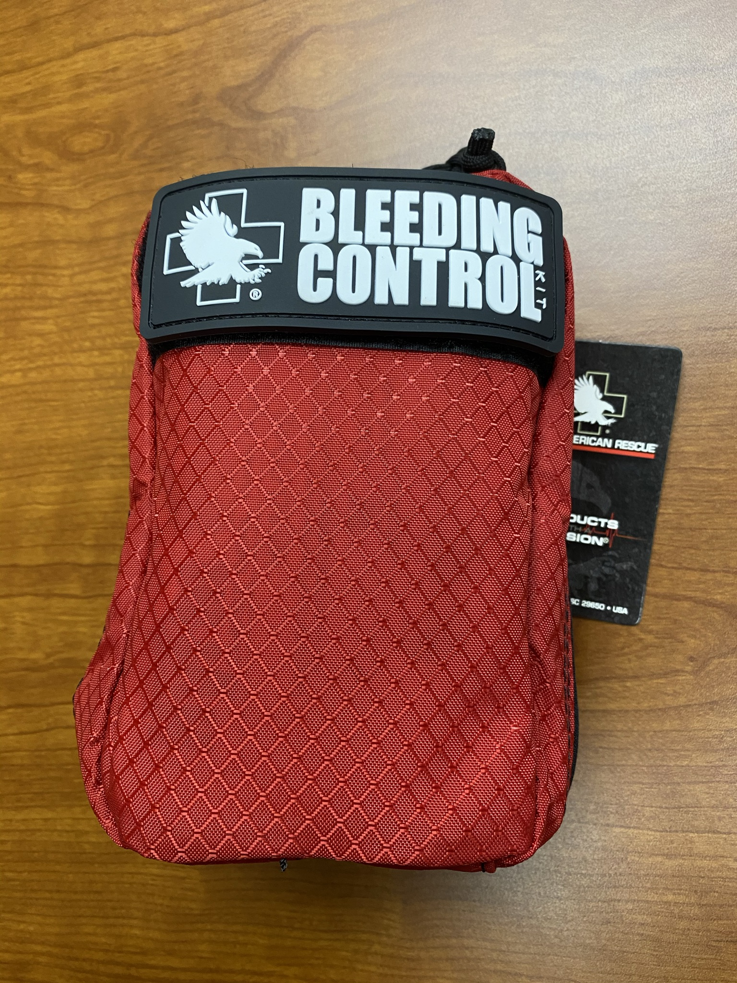
Notice
The presentation on its own does not replace officially certified bleeding control training. It is a quick overview of what is included in the Bleeding Control Kit from North American Rescue and some basic uses of the contents. It can be utilized by trained instructors as part of a certification course. You can get additional information on certification and training here:
  American Red Cross: Severe Bleeding Online
  Stop The Bleed Training
  Stop the Bleed: Mercy Medical Center

Slide 4

Kit Overview

Slide 5
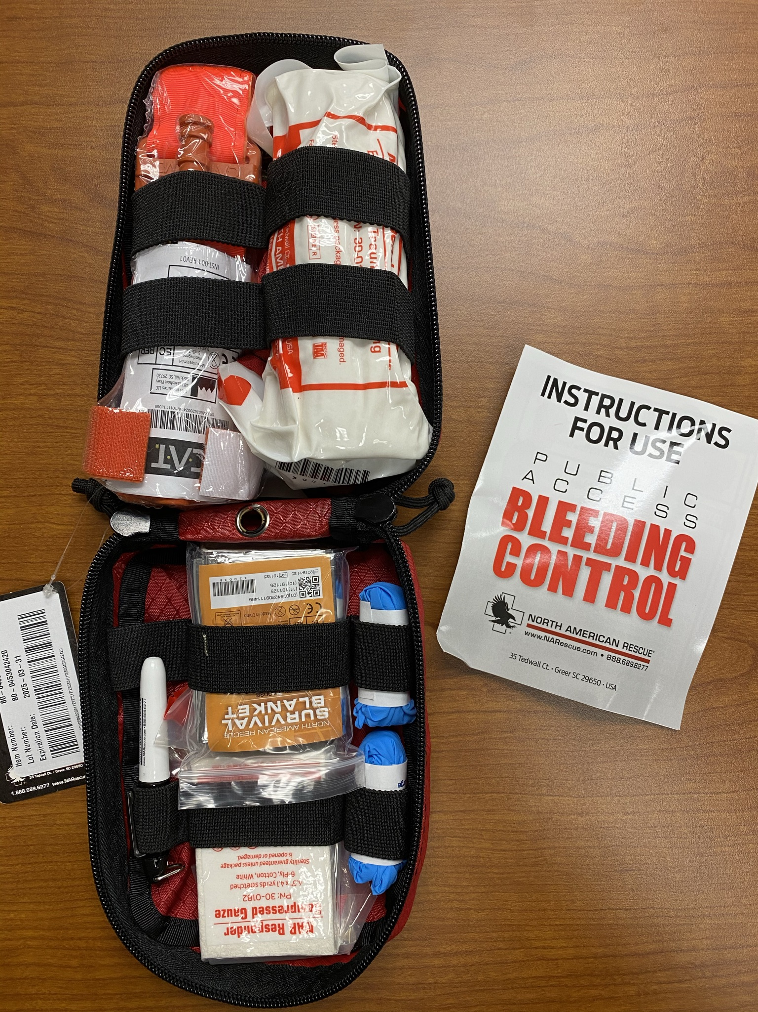
Bleeding Control Kit Contents
Nitrile Gloves (2)
Compressed Gauze (2)
Emergency Trauma Dressing
CAT Tourniquet
HyFin Vent Chest Seal Twin Pack
Black marker
Survival Blanket
Shears

Slide 6
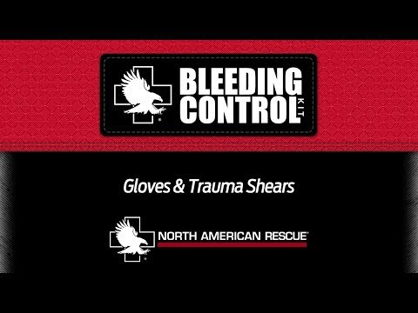
Nitrile Gloves and Shears

Slide 7
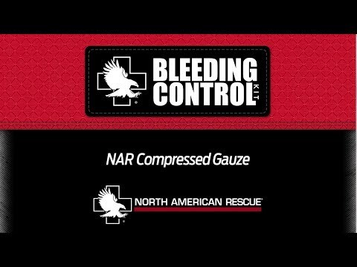
NAR Compressed Gauze

Slide 8
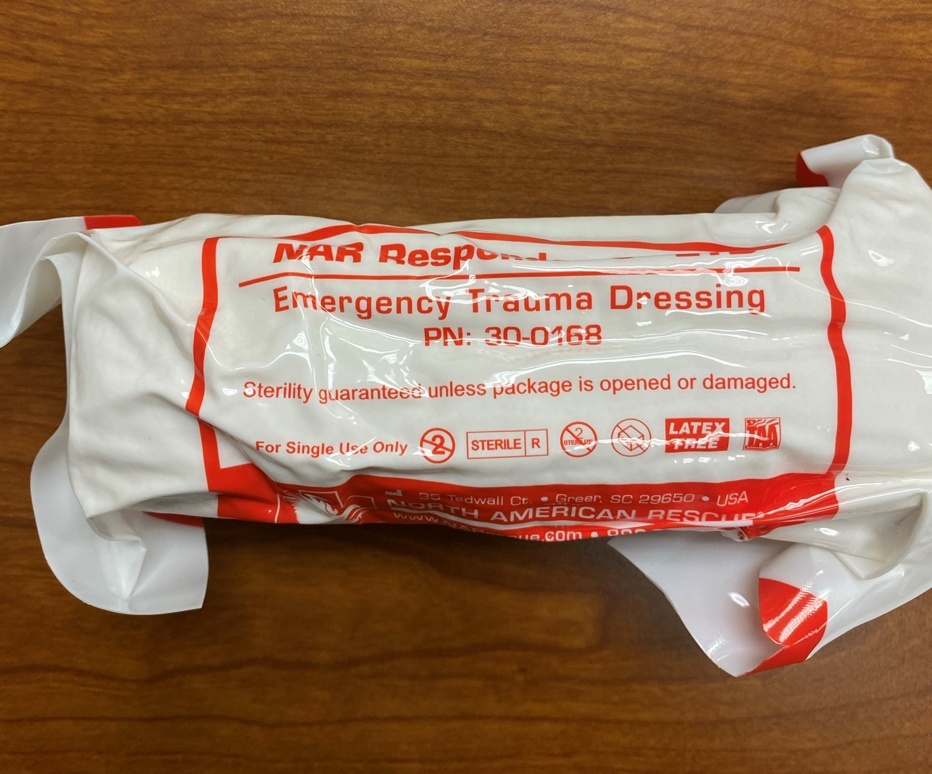
Emergency Trauma Dressing
Used to apply direct pressure to wound area
Vacuum sealed
Continue to apply direct pressure until bleeding has stopped

Slide 9
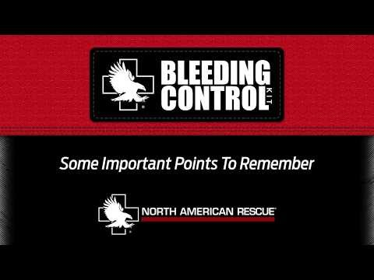
Emergency Trauma Dressing

Slide 10
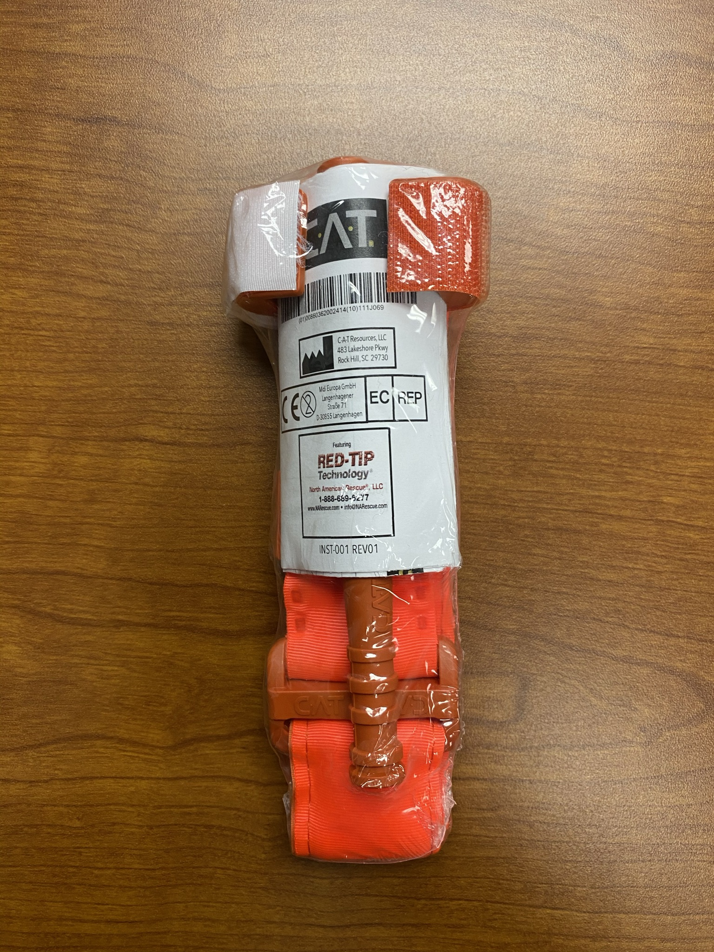
CAT: Combat Application Tourniquet
Used to occlude blood flow in the upper/lower extremities
CAT is designed to be applied one-handed

Slide 11
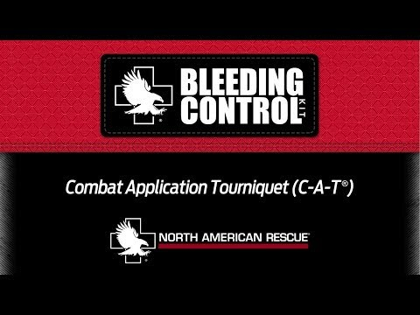
CAT: Combat Application Tourniquet

Slide 12
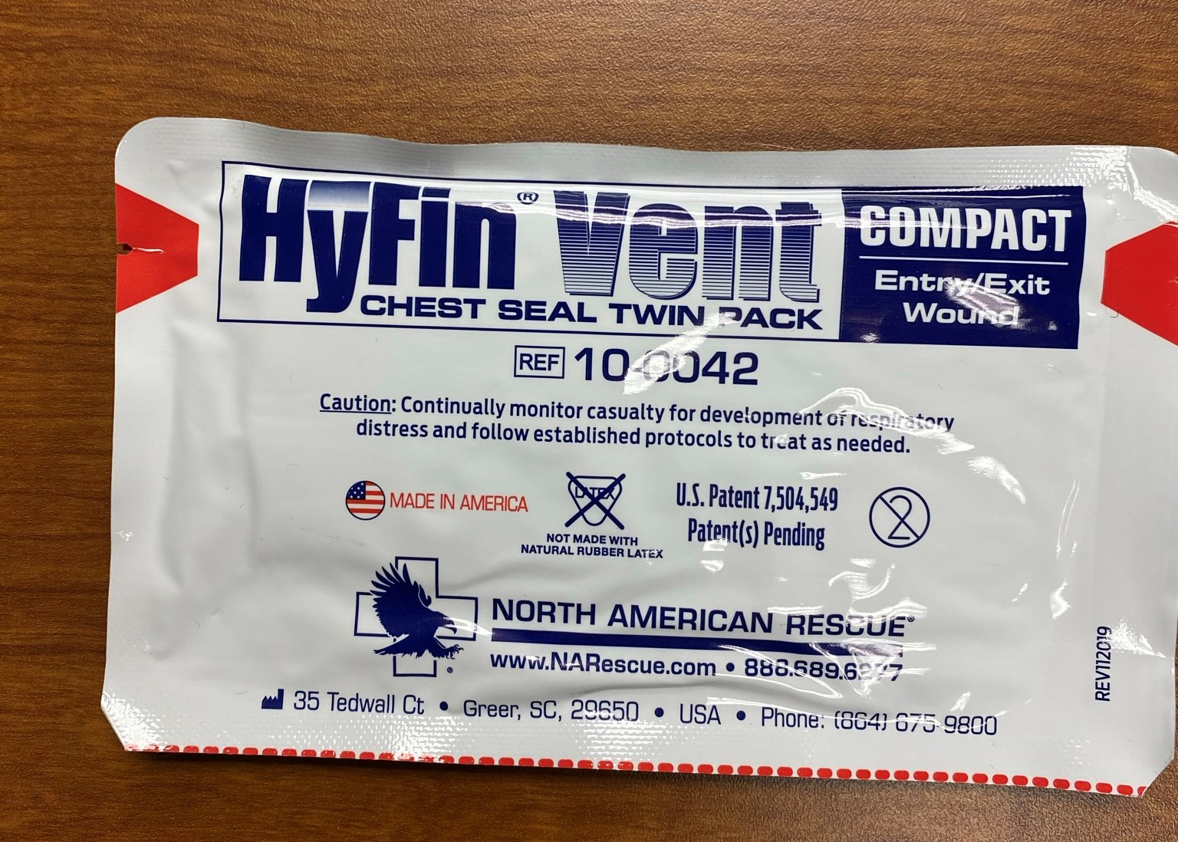
HyFin Vent Chest Seal
If the individual has a possible gun shot or puncture wound to the chest
  Remove chest clothing
  Listen for difficulty breathing, sucking noises
  Check for bleeding (front and back of body)
  If needed leave person in the recovery position

Slide 13
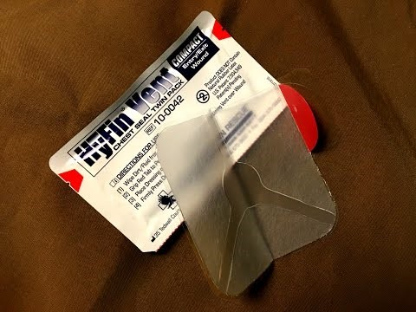
HyFin Vent Chest Seal

Slide 14
Additional Resources
https://www.narescue.com/videos
Mercy Medical Center Stop the Bleed Classes: https://www.cantonmercy.org/recent_news/mercy-medical-center-offers-free-stop-bleed-classes-community/#:~:text=Mercy%20Trauma%20Services%20is%20participating%20in%20a%20national,in%20a%20bleeding%20emergency%20until%20professional%20help%20arrives.

